Slide 1
Assignment2
Group 6:
Chengchao Fang
Chentao Han
Kai Wang
Yiran Jin

Slide 2
Steps
Step1: Identifying Actors and Use Cases
Step2: Construct Use Case Model
Step3: Build Connection Between Actors and Use Cases
Step4: Identifying Use Case Dependencies
Step5: Analyze the Function of Use Cases and Make Description for Each Attributes

Slide 3
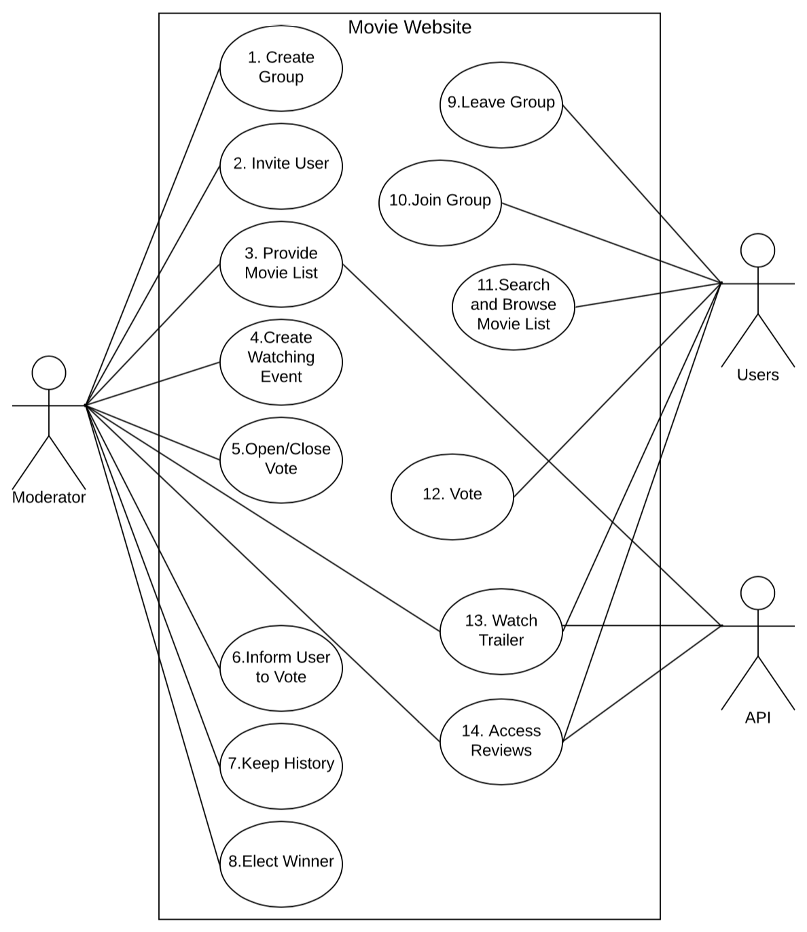
Use Case Diagram

Slide 4
Actors
Moderator: is a host who starts whole process
Users: all users in the application
API: the interface which can provide outside information

Slide 5
Use Case ID & Title: 1. Create Group
Author: Group 6
Date: February 10, 2020
Summary: Moderator can use this use case to create a movie watching group
Actors: Moderator
Preconditions: Moderator can access the web page which has a create group button
Postconditions: System has stored group information
Assumptions: Moderator just can create a group at one time
Exceptions: Group information loss ~ Check database storage setup

Slide 6
Use Case Description: This Use Case starts when the moderator decides to create a movie watching group. The system responds by storing new group information. This Use Case ends when a group was created.

Slide 7
Use Case ID & Title: 2. Invite Users
Author: Group 6
Date: February 10, 2020
Summary: Moderator can use this use case to invite users to join a group
Actors: Moderator
Preconditions: Moderator can access the web page which has an invite button
Postconditions: Users can be invited
Assumptions: Moderator just can invite a user at one time
Exceptions: Users can’t receive invite ~ Check connection between server and client

Slide 8
Use Case Description: This Use Case starts when the moderator wants to invite a user to created movie watching group. The system responds by delivering the invite message to the user. This Use Case ends when a user received an invite message.

Slide 9
Use Case ID & Title: 3. Provide Movie List
Author: Group 6
Date: February 10, 2020
Summary: Moderator can provide movie list for users to search and browse by API
Actors: Moderator, API
Preconditions: Moderator can access to the API
Postconditions: System can access the movie list by API
Assumptions: Moderator just can provide one movie list for one group
Exceptions: System can’t access movie list ~ Check the validation of API

Slide 10
Use Case Description: This Use Case starts when the moderator wants to provide movie list for movie watching group. The system responds by successfully accessing movie list as well as users. This Use Case ends when system and users can access the movie list.

Slide 11
Use Case ID & Title: 4. Create Watching Event
Author: Group 6
Date: February 10, 2020
Summary: Moderator can create a movie watching event
Actors: Moderator
Preconditions: Moderator can access the web page which has a create event button
Postconditions: System has stored event information
Assumptions: Moderator just can create an event at one time
Exceptions: Event information loss ~ Check database storage setup

Slide 12
Use Case Description: This Use Case starts when the moderator decides to create a movie watching event. The system responds by storing new event information. This Use Case ends when an event was created.

Slide 13
Use Case ID & Title: 5. Open/Close Vote
Author: Group 6
Date: February 10, 2020
Summary: Moderator can open and close a voting period for a specific movie watching event
Actors: Moderator
Preconditions: Moderator can access open/close button in a movie watching event
Postconditions: Vote option is open or close
Assumptions: Moderator just can open or close vote after creating watching event
Exceptions: Open/Close vote invalid ~ Debug the program

Slide 14
Use Case Description: This Use Case starts when the moderator decides to open or close the vote. The system responds by creating vote event. This Use Case ends when vote was opened or closed.

Slide 15
Use Case ID & Title: 6. Inform Users to Vote
Author: Group 6
Date: February 10, 2020
Summary: Users can be informed a movie watching event was created and they can vote for movies
Actors: Moderator
Preconditions: Moderator can access the web page which has an inform button
Postconditions: Users receive message to inform they can vote
Assumptions: Moderator can inform multiple users at the same time
Exceptions: Users can’t receive information ~ Check connection between server and client

Slide 16
Use Case Description: This Use Case starts when the moderator wants to inform users to vote for a movie watching event. The system responds by delivering the message to the user. This Use Case ends when a user received the information about vote.

Slide 17
Use Case ID & Title: 7. Keep History
Author: Group 6
Date: February 10, 2020
Summary: Moderator can keep history of movie watching event
Actors: Moderator
Preconditions: Moderator can access the movie watching event which has keep history button
Postconditions: System has stored the history
Assumptions: A movie watching event just be kept once
Exceptions: History information loss ~ Check database storage setup

Slide 18
Use Case Description: This Use Case starts when the moderator wants to keep the history of a movie watching event. The system responds by storing the history in database system. This Use Case ends when an event was kept.

Slide 19
Use Case ID & Title: 8. Elect Winner
Author: Group 6
Date: February 10, 2020
Summary: Moderator can elect a winner of movies in each movie watching event according to users’ vote
Actors: Moderator
Preconditions: Moderator can access the vote information to elect a winner
Postconditions: System storing the winner
Assumptions: A movie watching event just has one winner
Exceptions: Moderator can’t get vote information ~ Check connection between server and client

Slide 20
Use Case Description: This Use Case starts when the moderator wants to elect a winner for a movie watching event. The system responds by storing the winner in database system. This Use Case ends when a winner was elected.

Slide 21
Use Case ID & Title: 9. Leave Group
Author: Group 6
Date: February 10, 2020
Summary: Users can leave a group
Actors: Users
Preconditions: Users can access the web page which has a leave button
Postconditions: The user is not in the current group
Assumptions: The user can not leave group before joining
Exceptions: The user is still in group after leaving ~ Debug the program

Slide 22
Use Case Description: This Use Case starts when a user wants to leave a group. The system responds by deleting the user from the current group. This Use Case ends when a user leave from a group.

Slide 23
Use Case ID & Title: 10. Join Group
Author: Group 6
Date: February 10, 2020
Summary: Users can be informed a movie watching event was created and they can vote for movies
Actors: Moderator
Preconditions: Users can receive the invite message
Postconditions: System stores the user in the current group
Assumptions: A user just can join a group at one time
Exceptions: Users can not receive the invite ~ Check the connection between server and client

Slide 24
Use Case Description: This Use Case starts when a user wants to join a group. The system responds by inserting the user to the current group. This Use Case ends when a user join a group.

Slide 25
Use Case ID & Title: 11. Search and Browse Movie List
Author: Group 6
Date: February 10, 2020
Summary: Users can be informed a movie watching event was created and they can vote for movies
Actors: Moderator
Preconditions: Users can access to the movie list
Postconditions: Users can search and browse the movie list
Assumptions: Every user in the group can access the movie list
Exceptions: Users can’t access movie list ~ Check the validation of API

Slide 26
Use Case Description: This Use Case starts when a user wants search and browse the movie list. The system responds by leading the user to get the movie list from API. This Use Case ends when a user are searching and browsing the movie list.

Slide 27
Use Case ID & Title: 12. Vote
Author: Group 6
Date: February 10, 2020
Summary: Users can be informed a movie watching event was created and they can vote for movies
Actors: Moderator
Preconditions: Users can receive the informed message
Postconditions: Users can have a vote and moderator can get the feed back
Assumptions: A user just can vote once
Exceptions: Moderator can’t get the feedback ~ Check the connection between server and client

Slide 28
Use Case Description: This Use Case starts when a user is informed a movie watching event was created and they can vote for movies. The system responds by recording the vote information and transferring the vote information to moderator. This Use Case ends when a user successfully vote for a movie watching event.

Slide 29
Use Case ID & Title: 13. Watch Trailer
Author: Group 6
Date: February 10, 2020
Summary: User can watch trailers of movie provided by API
Actors: Moderator, API, Users
Preconditions: Users can access to the trailer watching event
Postconditions: Users can watch trailer provided by API
Assumptions: Multiple users can watch the same trailer at the same time
Exceptions: Users can’t access movie trailer ~ Check the validation of API

Slide 30
Use Case Description: This Use Case starts when a user want to watch the trailer of movies. The system responds by providing trailer information according to API. This Use Case ends when a user can watch the movie trailer.

Slide 31
Use Case ID & Title: 14. Access Reviews
Author: Group 6
Date: February 10, 2020
Summary: User can access reviews of movies provided by API
Actors: Moderator, API, Users
Preconditions: Users can access to the reviews watching event
Postconditions: Users can watch reviews provided by API
Assumptions: Multiple users can watch the same reviews at the same time
Exceptions: Users can’t access movie reviews ~ Check the validation of API

Slide 32
Use Case Description: This Use Case starts when a user want to watch the reviews of movies. The system responds by providing reviews information according to API. This Use Case ends when a user can access the reviews of movies.

